Slide 1

BMW Sales & Pricing Insights
End-to-end data analysis: 2010–2024
Dataset: Kaggle.com | Tools: Excel, Power Query, Pivot Tables, Dashboards
Presented by: Rupnath Shaw

Slide 2


Problem Statement
Objective
Key Focus
Analyze BMW's global sales trends 2010–2024
Top models & regions
Pricing & mileage impact
Market & fuel trends
Goal
Support marketing, production & pricing decisions with data-backed insights

Slide 3

Data Cleaning Process
Performed in Excel Power Query Editor
Data Validation
Null Handling
Standardization
Removed duplicates, unnecessary index rows
Replaced or removed null values
Corrected region/city names (e.g., "Asai" → "Asia")
Type Conversion
Calculated Columns
Final Validation
Year → Integer, Price → Currency
Price_Band & Mileage_Band segmentation
Consistent formatting across dataset
✅ Result: Clean, reliable dataset ready for visualization

Slide 4
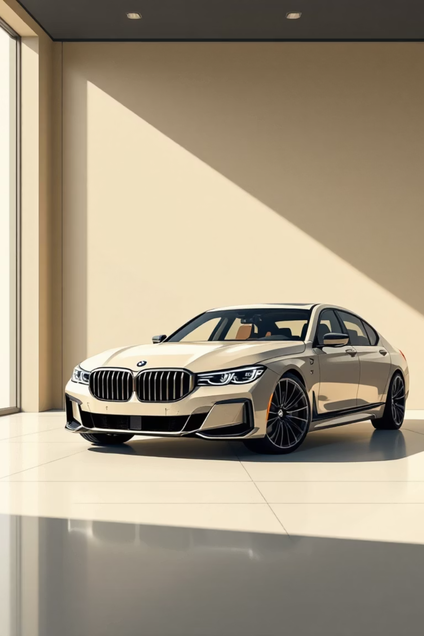
Overall Performance Metrics
25.3M
$75K
Total Sales Volume
Average Price
Units sold globally
Consistent premium positioning
Top Model
Top Region
7 Series leads sales volume
Asia dominates market share
Recommendation: Focus on Asia for upcoming launches. Promote premium 7 Series variants with luxury features.

Slide 5
Sales by Model Analysis
93%
92%
91%
7 Series
i8
3 Series
23.7M units | Market leader
23.4M units | Strong performer
23.2M units | Consistent demand
Average price stable across models: $74k–$75k
Recommendation: Maintain steady production for 7 Series and i8. Introduce new trims for 3 Series to rejuvenate demand.

Slide 6




Regional Performance
Asia
Europe
42.9M units
42.5M units
Highest sales volume
Strong traditional market
Other Regions
North America
Mid-level performance
42.4M units
Growth opportunity
Stable performance
Recommendation: Expand dealership infrastructure in Asia and Africa. Launch localized campaigns matching cultural preferences.

Slide 7


Fuel Type & Transmission Trends
Transmission Split
Rising Adoption
49%
Electric Models
Automatic
Growing market share
24.8k units
Hybrid Models
51%
Increasing demand
Manual
25.1k units
Recommendation: Prioritize Electric and Hybrid Automatic models for premium buyers. Launch EV efficiency campaigns.

Slide 8

Yearly Sales Trends
Steady growth trajectory from 2010–2024
2010–2019
2020
2021–2024
Consistent growth phase
Minor dip (pandemic effect)
Recovery & stabilization
Price Stability
Future Outlook
Consistent ~$75k average throughout period
Post-2024 innovation focus
Recommendation: Maintain stable pricing. Invest in electric & autonomous lines to sustain growth.

Slide 9

Price & Mileage Analysis
Price Band Distribution
Mileage Band Insights
≤$50k
$80–110k
≤50k miles
100–150k
Entry segment
Premium tier
Low mileage premium
Strong secondary market
$50–80k
>$110k
50–100k
>150k
Mid-range dominance
Ultra-luxury
Highest resale volume
Value segment
Recommendation: Develop region-based promotions for luxury models. Offer warranty extensions for mid/high-mileage vehicles.

Slide 10
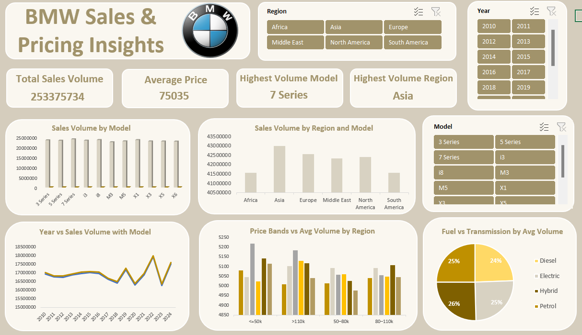
Dashboard

Slide 11

Executive Summary
Market Leader
Regional Champion
Future Focus
Price Stability
7 Series dominates as brand flagship with 23.7M units
Asia represents highest growth potential at 42.9M units
Electric/Hybrid models show rising adoption rates
Consistent $75k average maintains premium positioning
Strategic Recommendations
Expand EV lineup and marketing in Asia
Focus R&D on efficiency + luxury blend
Maintain premium perception through consistent customer experience

